Slide 1
Steering meeting: 5
2018-12-10

Slide 2
Outline
Project status
Last week's accomplishments
What we planned to do...
What we actually did...
Time report
This week's plan
Identified issues
Questions

Slide 3
Project status
Feels like we are on time

Slide 4
Last week's accomplishments What we planned on doing:
Finish Design Document draft
Finish redo of project plan
Backend: Provide required PHP for the frontend group.
Frontend: Implement components:
- Erika: Navbar
- Filip: Tables
- Sai: Search
- Christoffer: Timeline
- Christoffer: Merge the parts and upload it to master

Slide 5
What we actually did...
Design document
First draft handed in.

Slide 6
What we actually did...
Project plan
Redo finished. Awaiting feedback.

Slide 7
What we actually did...
Frontend
Researched different Navigation bars with react
Uses both react and bootstrap for a smoooooth look
Needs connection in the tabs

Slide 8
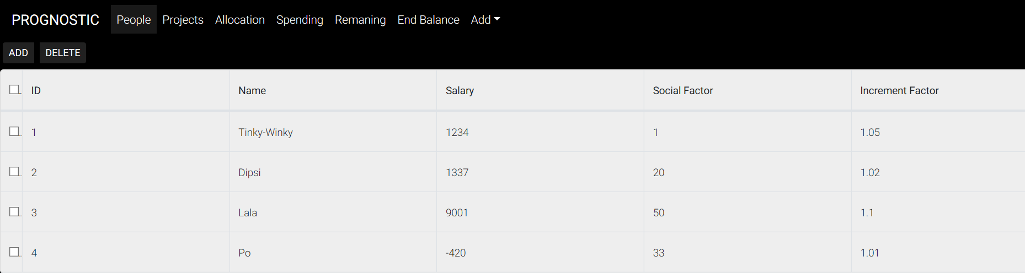
What we actually did...
Frontend
Table made. Needs connection to database.

Slide 9
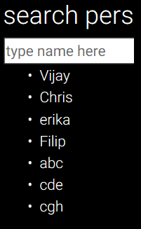
What we actually did...
Frontend
Search function of people implemented.

Slide 10
What we actually did...
Frontend - Timeline
Researched different implementations, decided to go with react-visjs-timeline.
Made an initial design, but adjusted it later to the feedback received by Jan.

Slide 11
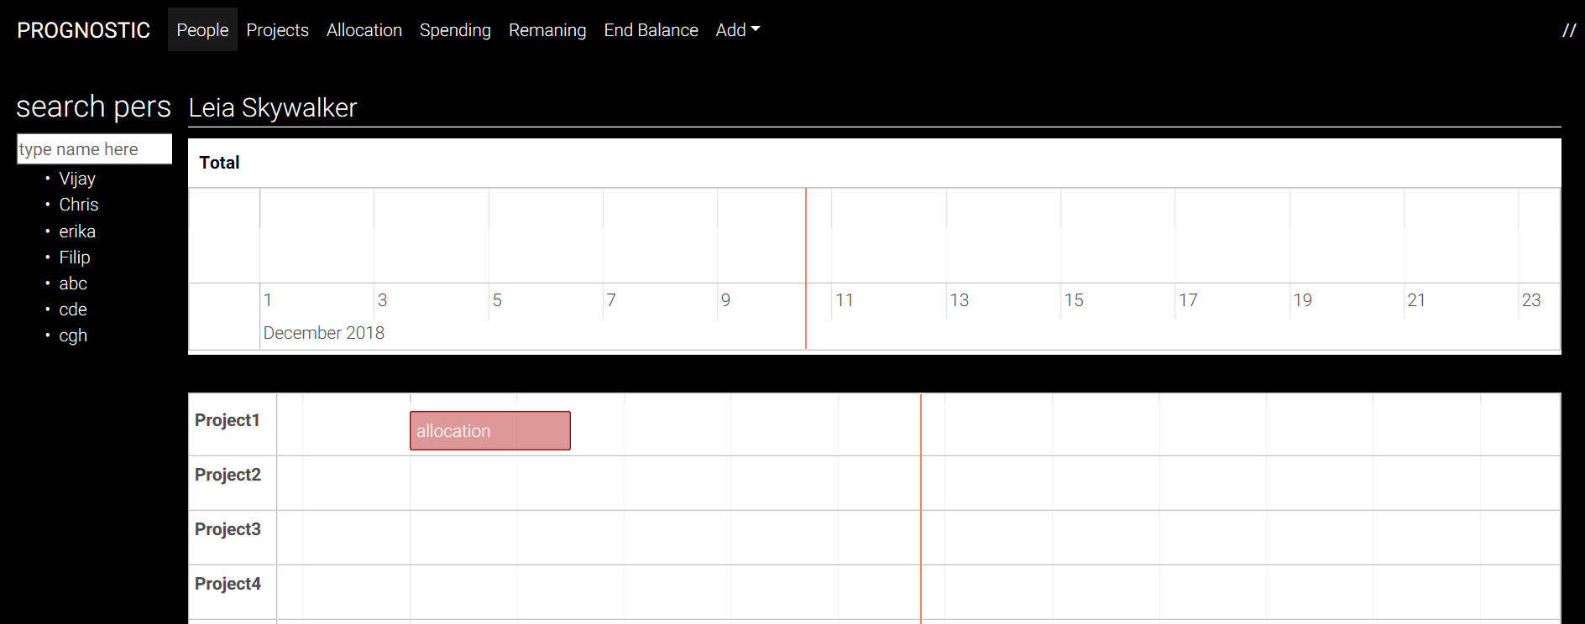
What we actually did...
Frontend
Merged components:

Slide 12
What we actually did...
Backend
[Goal: Provide required PHP for the frontend group.]
Convert php files to present data with JSON

Slide 13
This week's plan
Work on the Design document feedback.
Prepare class presentation.
Frontend:
Implement NavBar functionality.
Create the rest of the tables.
Make a component that talks to server and callback all tabs (observer)
Improve timelines
Started with design and improve it as we go
GIT-lecture
Backend:
Connect with Frontend (tables)
Send data to database

Slide 14
Identified issues
Communication, communication, communication
Responsibilities

Slide 15
Name | Hours | TOTAL | What has been done
Filip | 18.5 | 30 | Frontend meeting, document writing, meeting slides, researching and implementing tables.
Matko | 11 | 30 | Project document writing and review, learning about react, starting with frontend implementation.
Osamah | 12 | 32 | Working with Detailed Design Description, Preliminary design presentation, PHP files, React
Zaid | 11 | 29 | Worked with the document and the presentation, php files and react
Christoffer | 18.5 | 48.8 | Frontend meeting, document writing, researching and implementing the allocation view, merged stuff on git and fixed a demo for client and steering.
Mohammed | 7.5 | 33.5 | Programmed Backend (PHP And SQL)
Sai | 11 | 31 | Frontend meeting, document writing, researching and implementing the Search function
Erika | 17.5 | 44.5 | Frontend meeting, document writing, learning about react but also implement Navigation bar in react
GROUP | 2 | 20 | Meetings, project plan writing, etc...

Slide 16
Questions
Not a question but... the dev branch on GitHub is always the most updated (Master gets merged when we are absolutely certain)
Redo the Design Draft or should it be in the 17th Jan? :)

